Slide 1

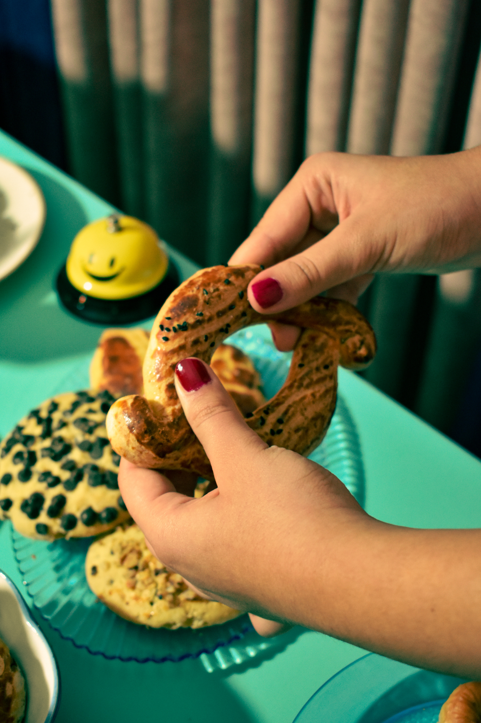
Analysis of Food and Beverage Industry
Presented By:
Shimpa Sethi
Batch
MIP-DA-13

Slide 2
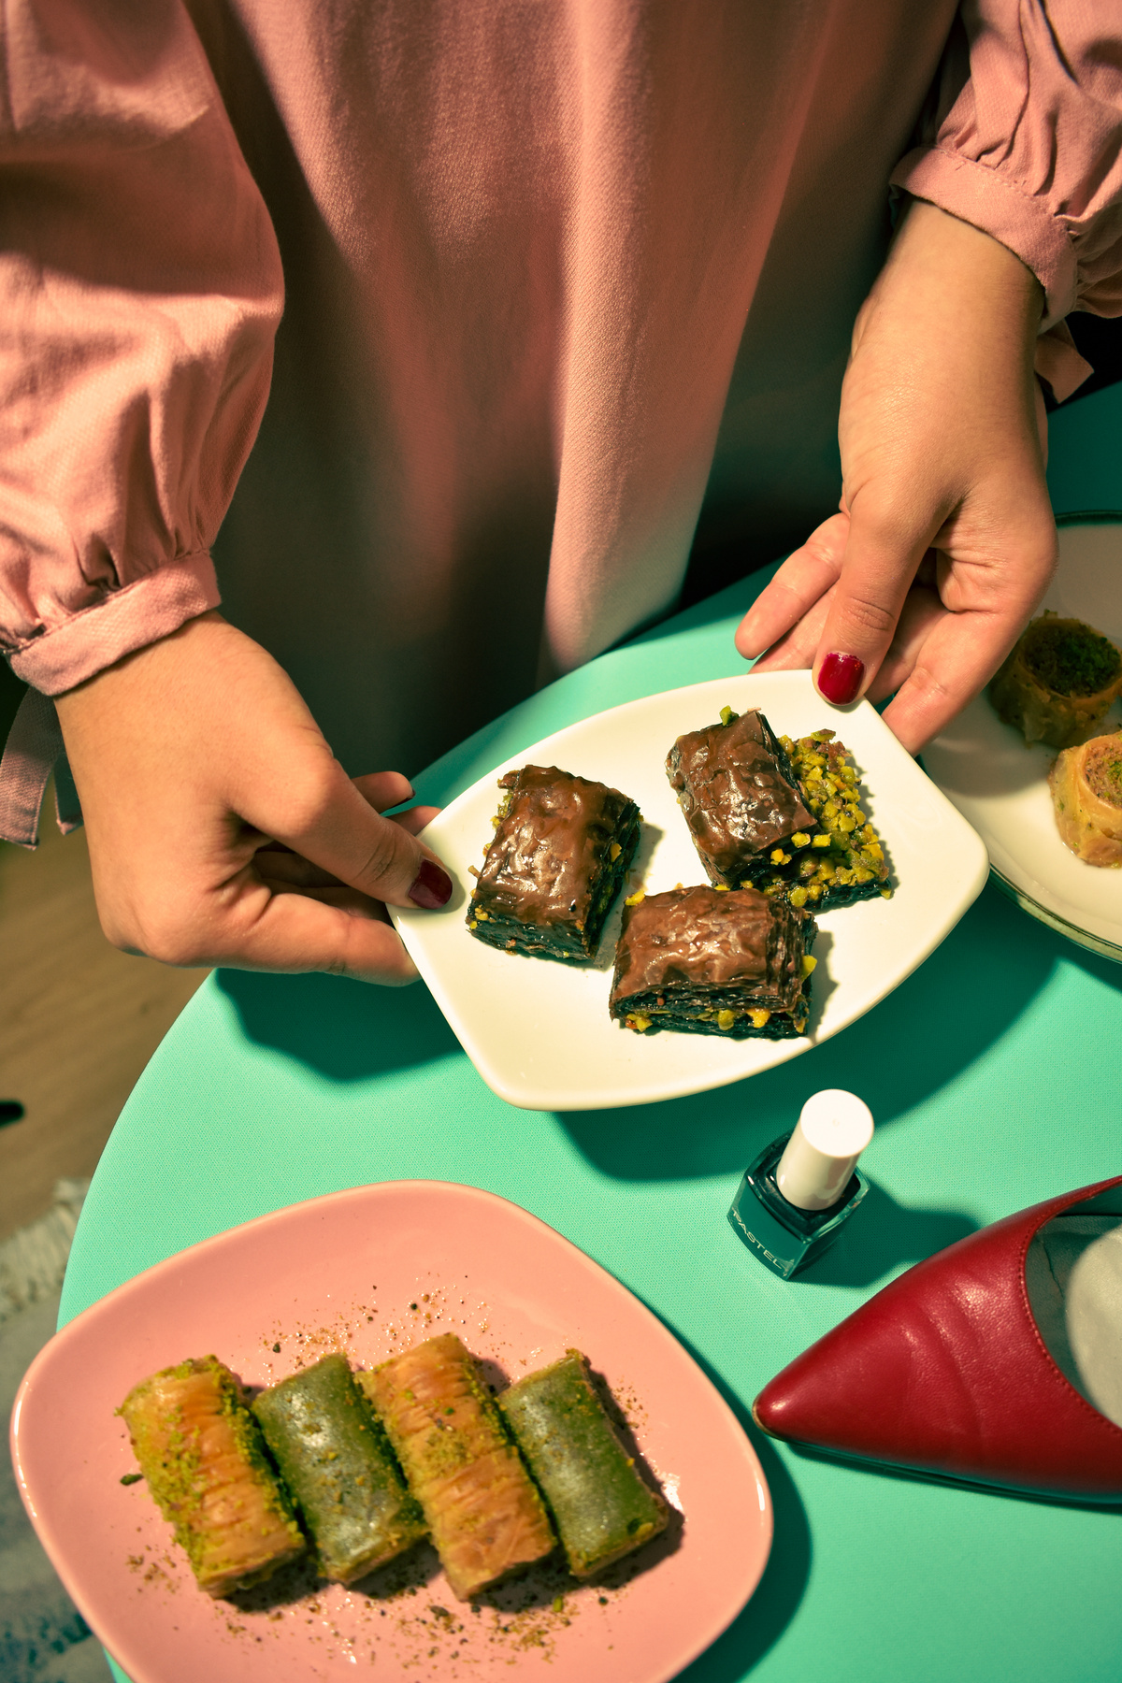
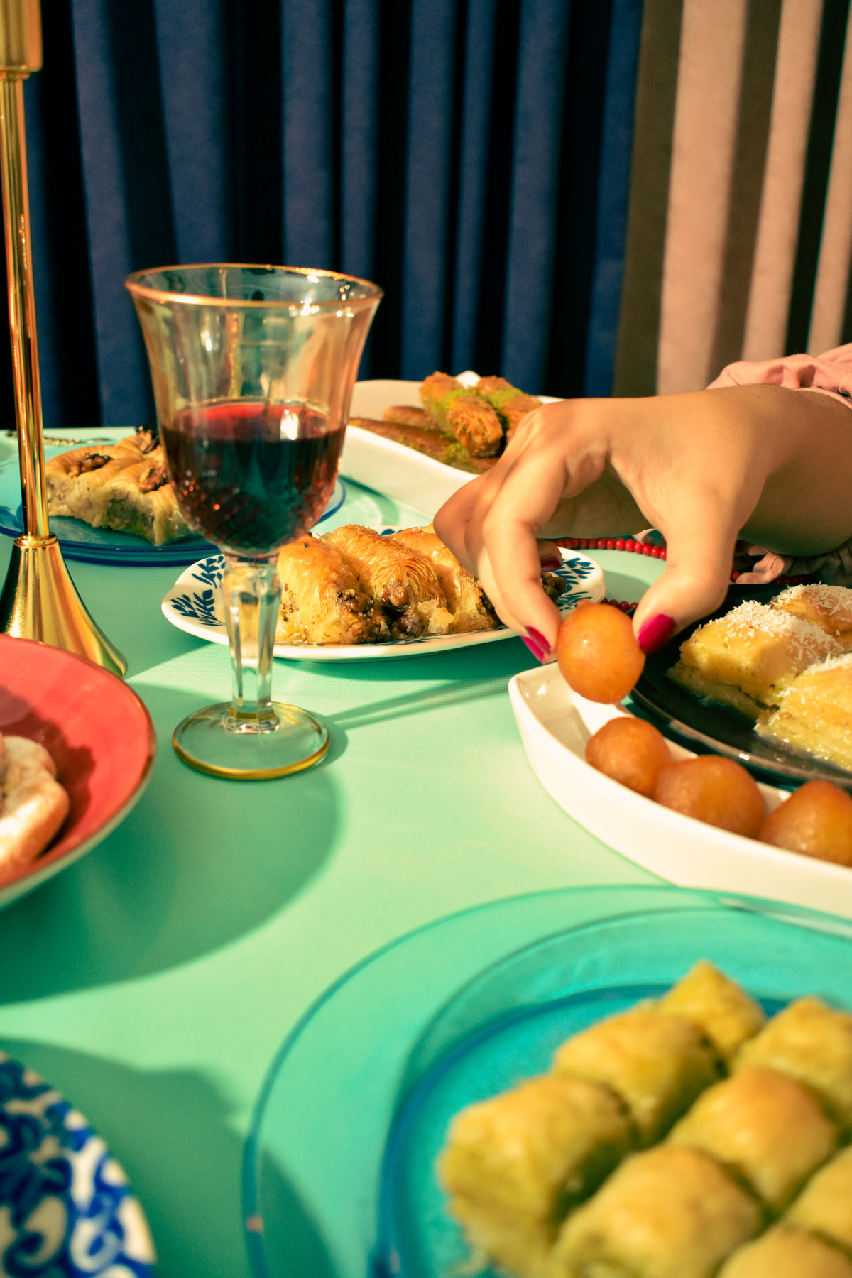
Overview
Identify key trends, understand brand perception, and explore potential areas for improvement in
product offerings and marketing strategies.

Slide 3
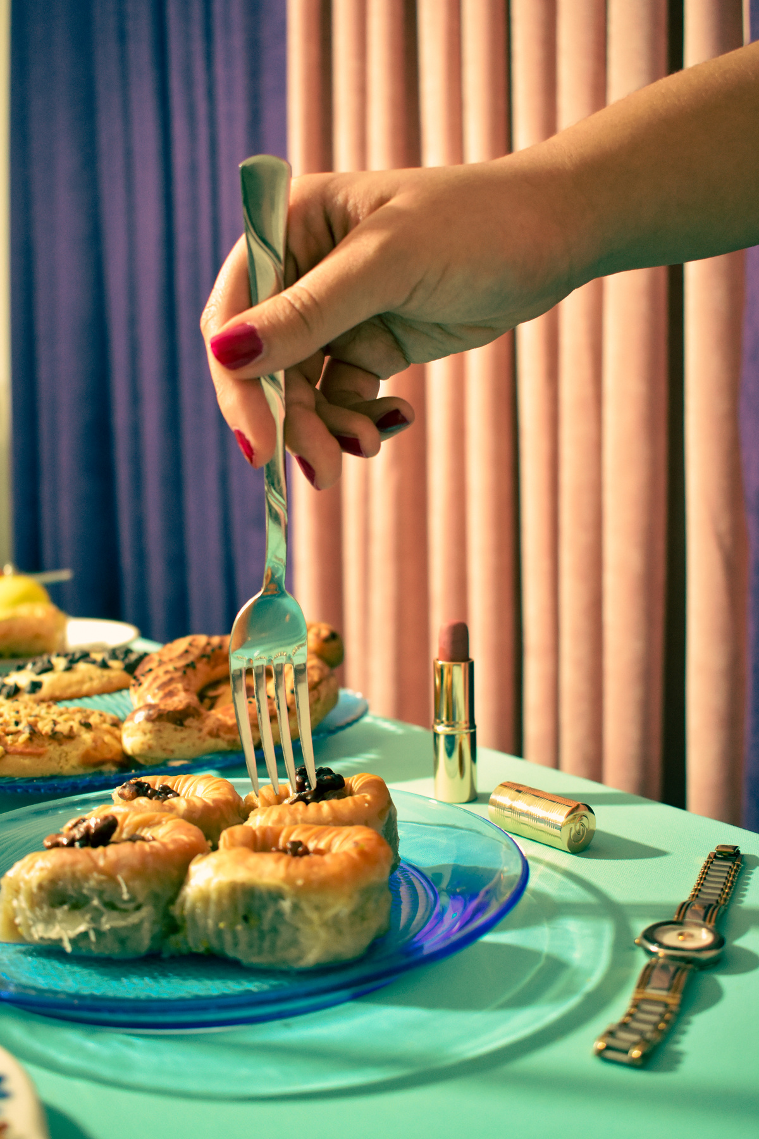
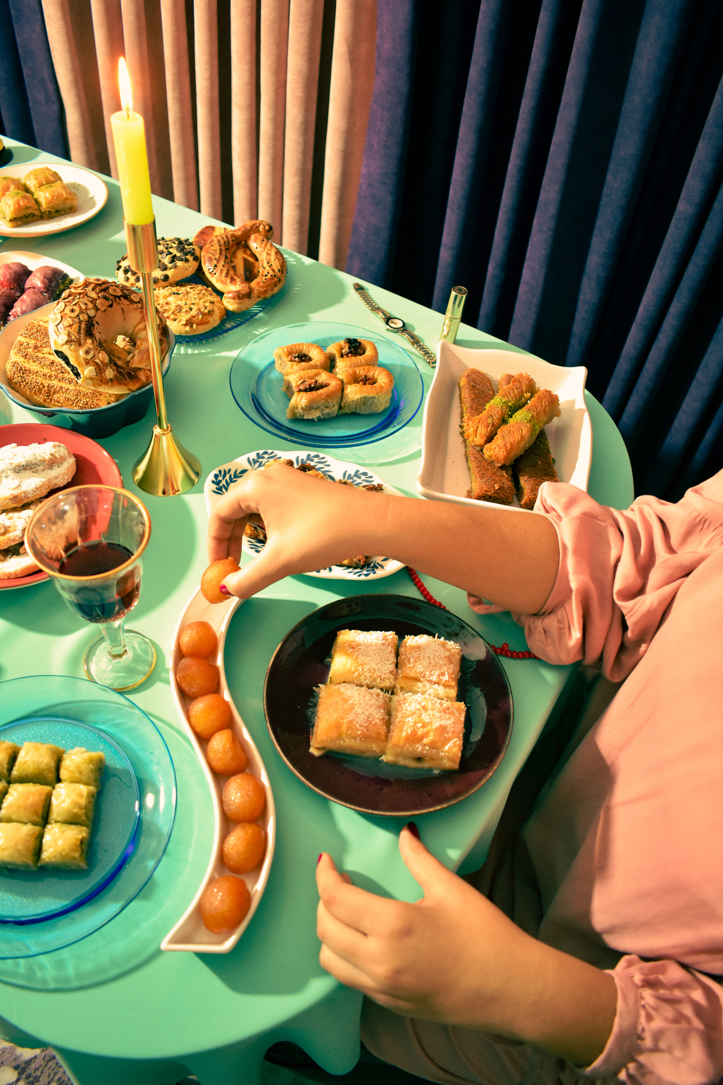
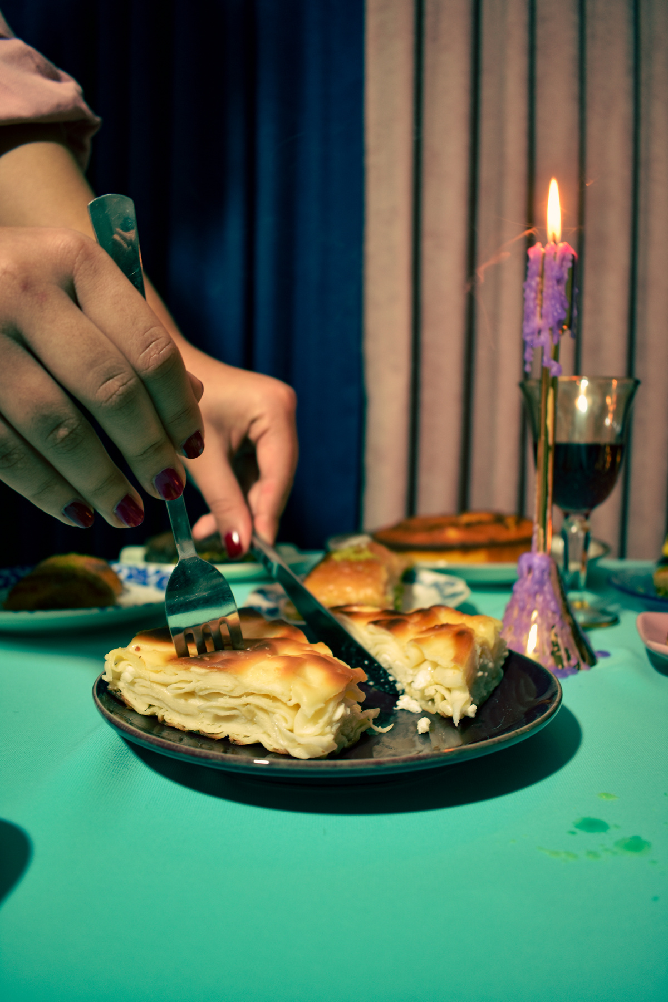
Objectives and Goals
This Power BI project aims to analyze survey responses from the food and beverage industry to gain insights into consumer behavior, preferences, and perceptions.

Slide 4
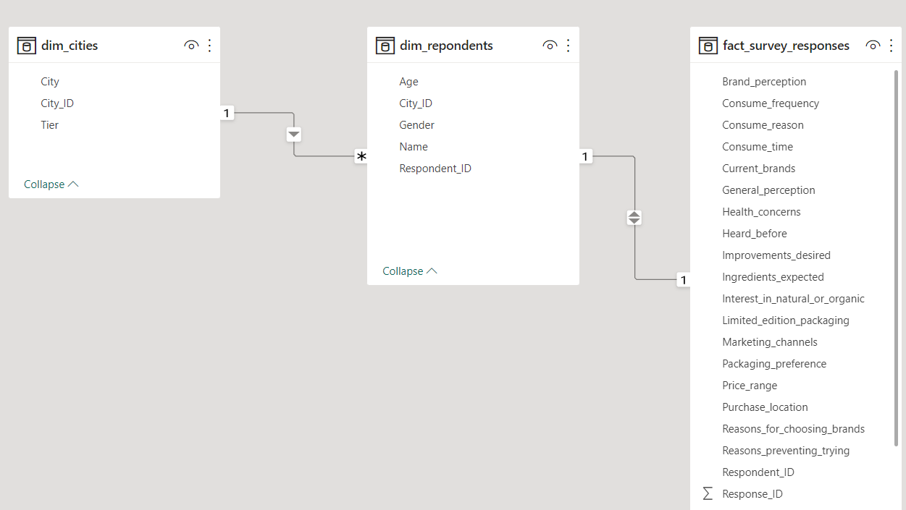
DATA MODEL

Slide 5
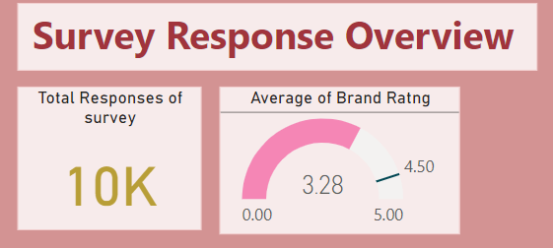

Slide 6
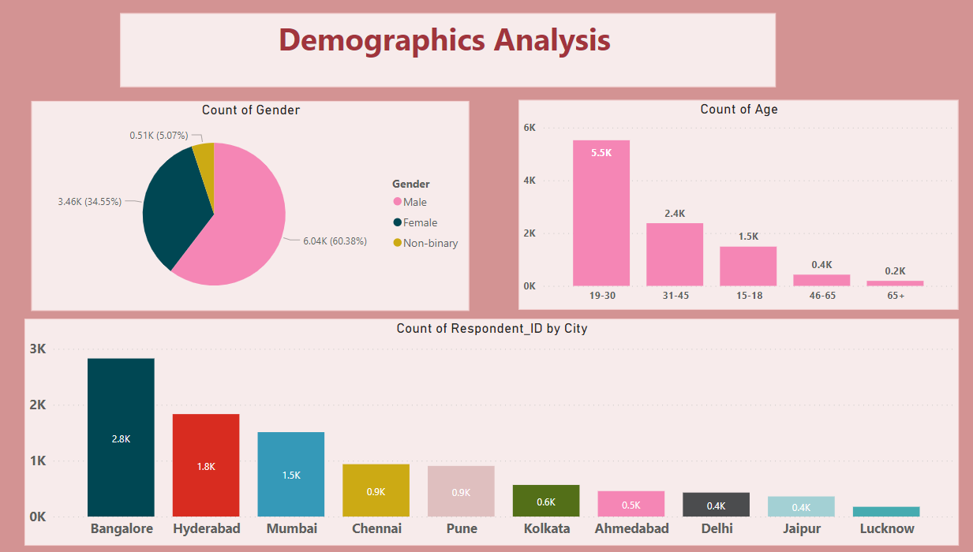

Slide 7
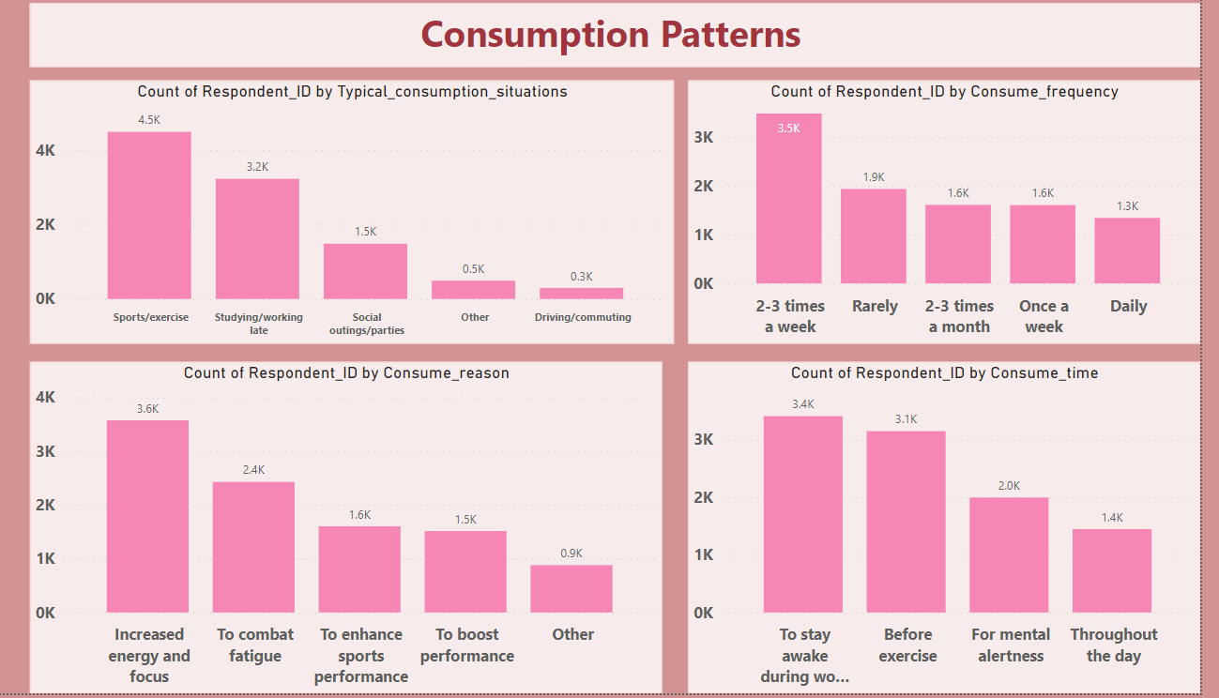

Slide 8
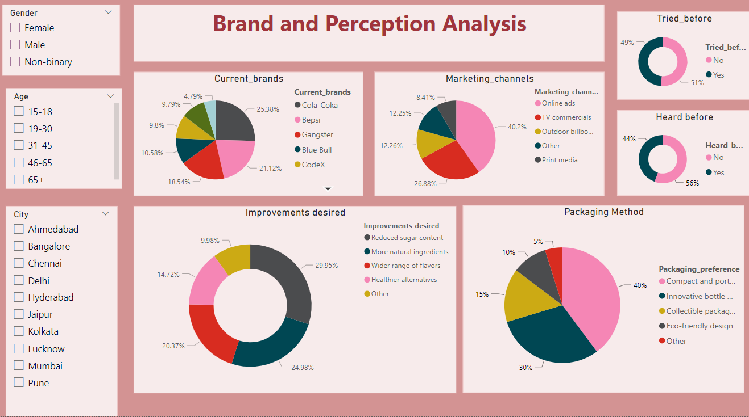

Slide 9
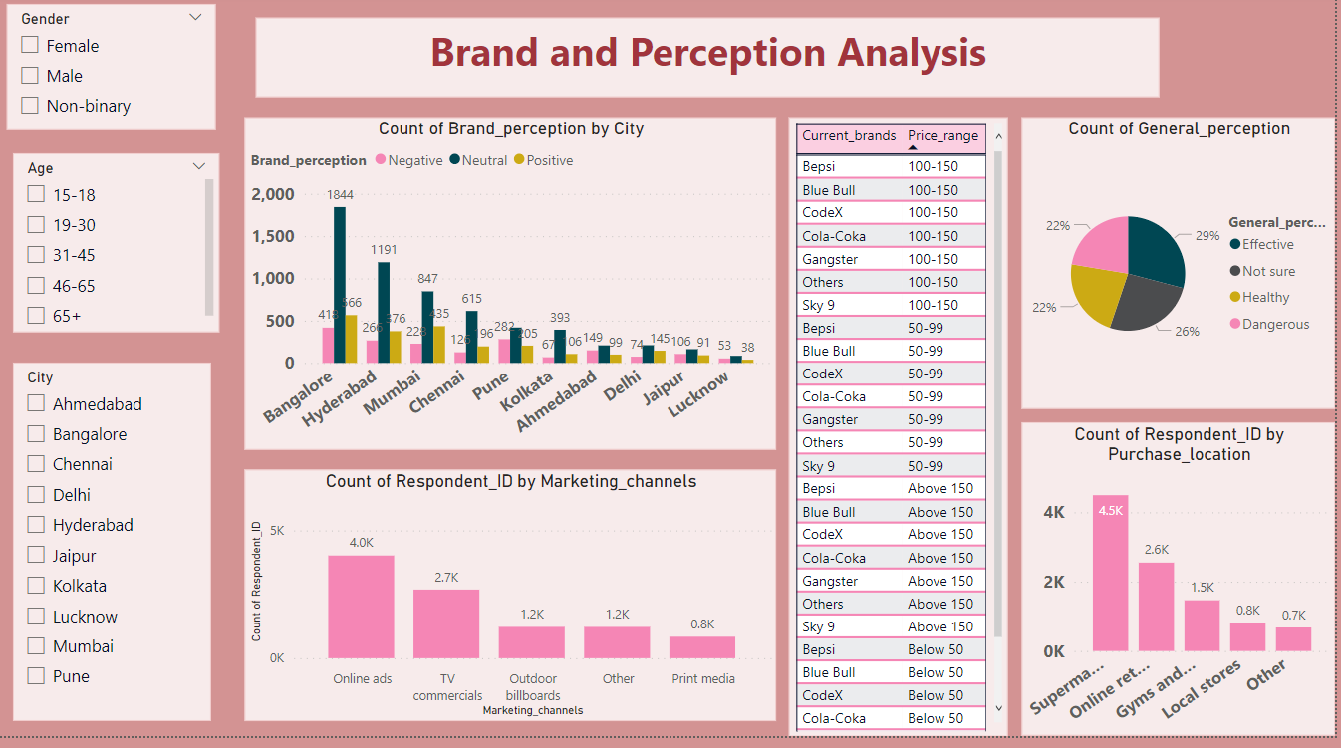

Slide 10
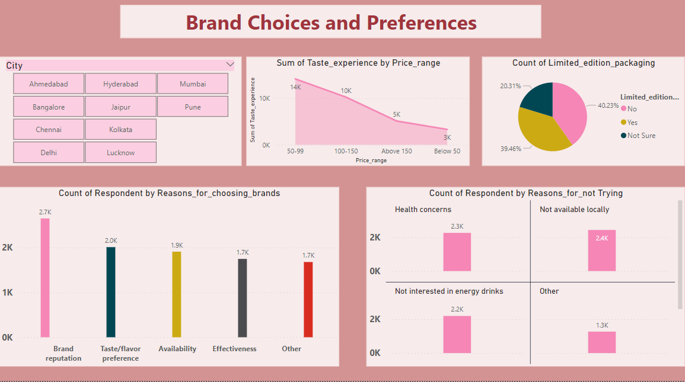

Slide 11
Key Insights:
Cola-Coka accounted for 25.38% of Count of Current_brands.
﻿Reduced sugar content accounted for 29.95% of Count of Improvements_desired.
﻿Online ads accounted for 40.20% of Count of Marketing_channels.
39.84% of Count of Packaging_preference, preferred for Compact and portable cans .
﻿Effective had the highest Count of General_perception at 2,909, followed by Not sure, Healthy, and Dangerous.﻿﻿﻿﻿﻿﻿Effective accounted for 29.09% of Count of General_perception.﻿﻿﻿

Slide 12
Key Insights:
﻿
﻿﻿Bangalore in Brand_perception made up 18.44% of Count of Brand_perception.﻿﻿
Neutral had the highest total Count of Brand Perception, at 5,974, followed by Positive, at 2257, and Negative, at 1769.﻿
To stay awake during work/study had the highest Count of Respondents at 3,409, followed by before exercise, for mental alertness, and Throughout the day.

Slide 13
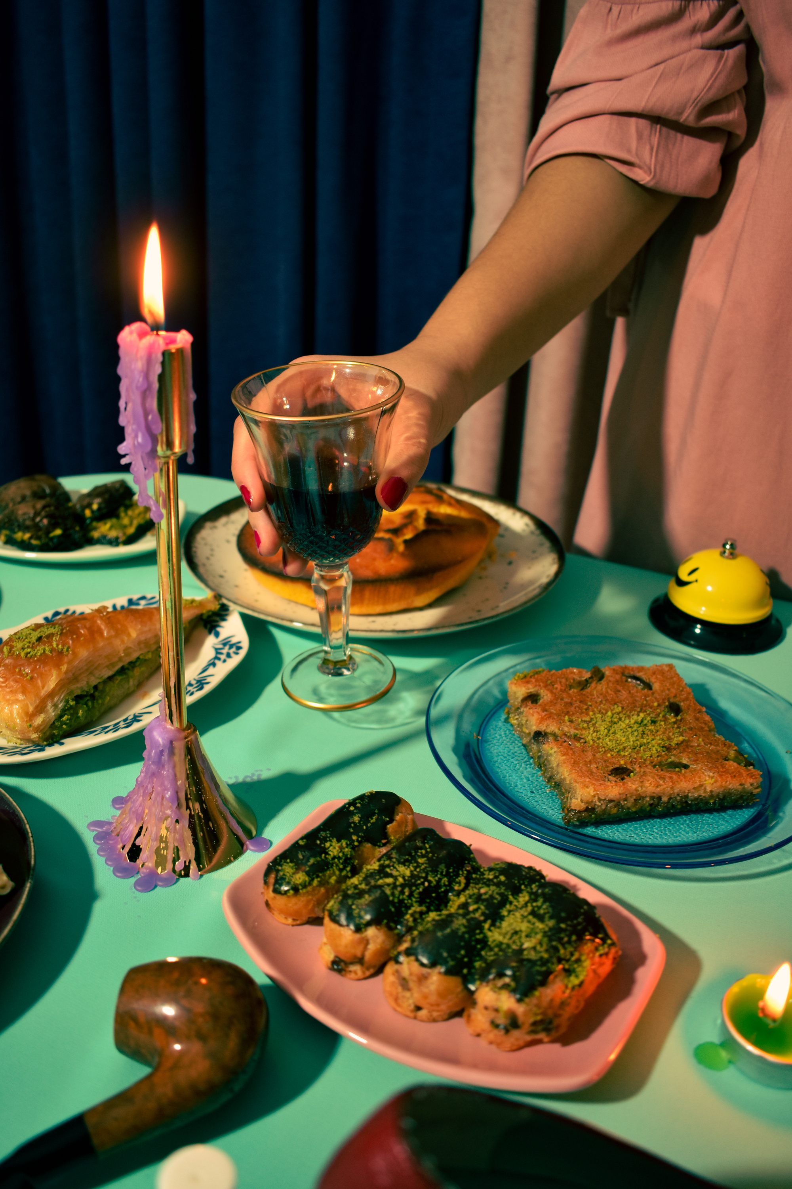
Thank you!
Thank you all for going through this project brief.

